Slide 1


BEER ANALYSIS REPORT

Slide 2
Definition
Beer is defined as a fermented alcoholic beverage made from barley wheat and rice. & flavoured with hops
Beer is one of the oldest and most widely consumed alcoholic drinks in the world and the third most popular drink overall after water and tea
Beer forms part of the culture of many nations and is associated with social traditional such as beer festivals

Slide 3
History of Beer
Historians believe prehistoric man made beer before learning to make bread. Beer has been referred to as ‘liquid bread’ 4300 BC.- Babylonian clay tablets include recipes for making beer. Beer had become then,as it is today, a vital part of civilization.

Slide 4
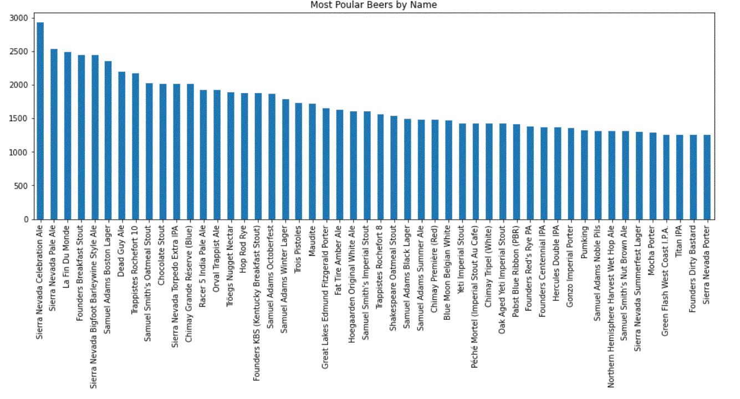
BEER NAMES

Slide 5
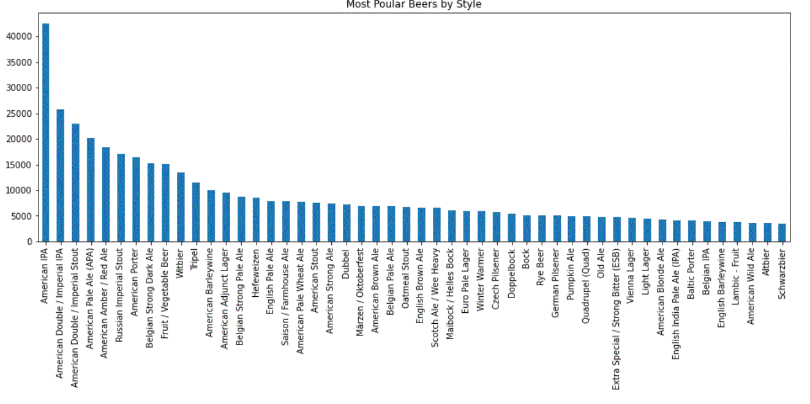
BEER STYLES

Slide 6
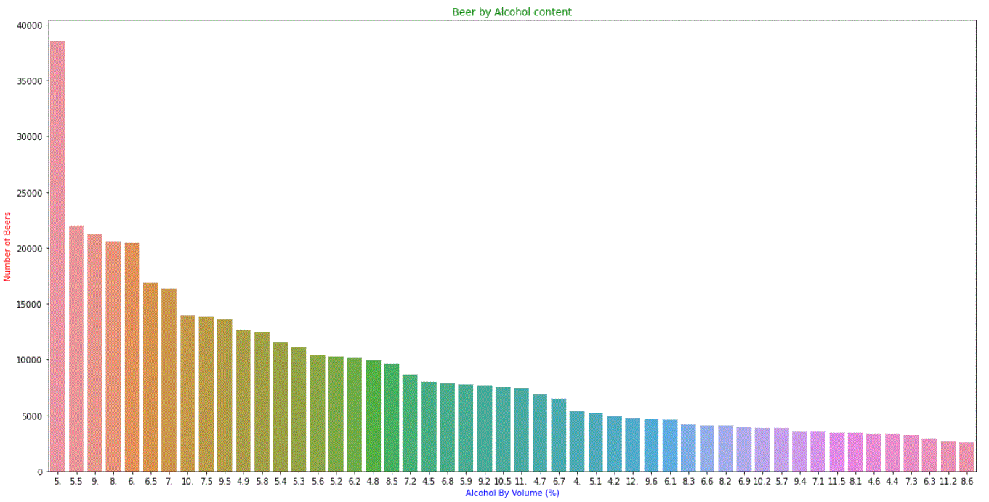
Number of Beer by Alcohol Content

Slide 7
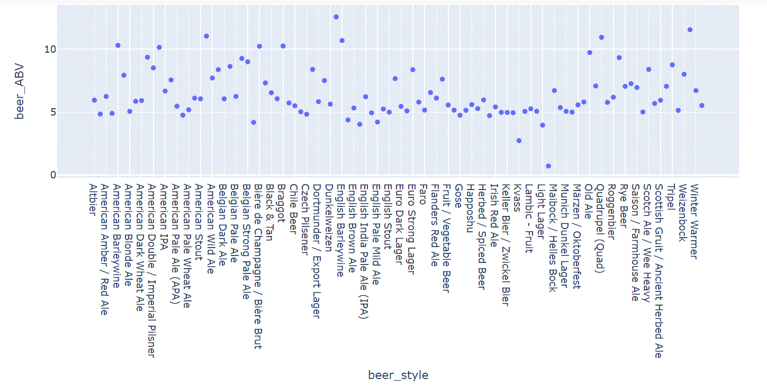
Beer Style vs Beer_ABV
Almost all Beer style have an average alcohol volume , ABV > 4%

Slide 8
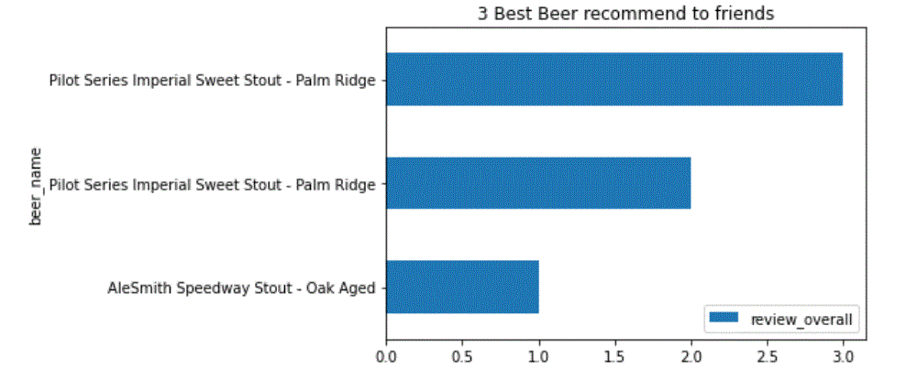
Top 3 Breweries Produce Strong Beer

Slide 9
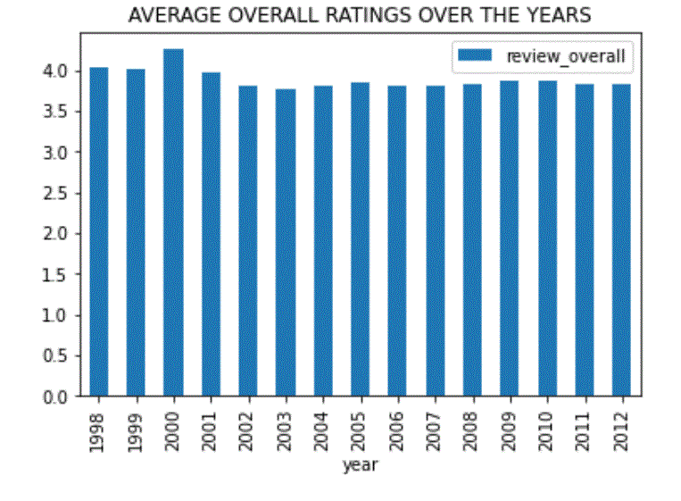
Year Enjoy Beer Highest Rating
Year 2000 got highest rating of 4.24% followed by year 1998, 1999 rating 4.045 & 4.0

Slide 10
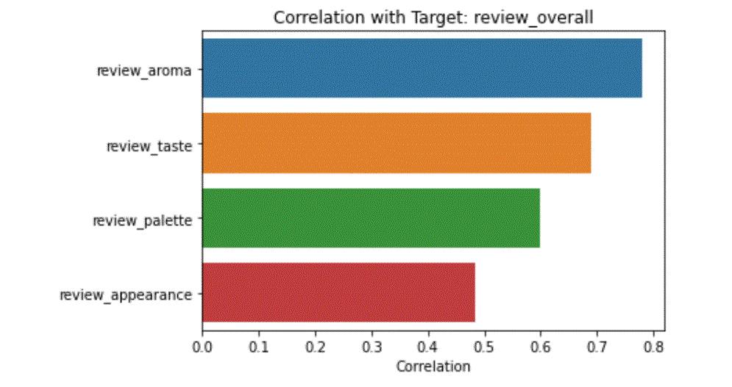
Important Beer Factor Based on Users
Based on user factor review_aroma is most corelated with review_overall and thus conclude important feature

Slide 11
Recommend 3 Beer To Friends

Slide 12
Favourite Beer Style Based on review written by Users
The Most Favourite ‘Beer_Style’ based on review written by users are:
American Adjunct Lager
Marzen / Oktoberfes
English Porter
Fruit / Vegetable Beer

Slide 13
review Compare to overall review score for the beer style
By observing the mean compound ploaratiy score , we can say that the beer style ‘Braggot’ is quite famous
By Observing the mean compound polarity score calculated we can get an idea how the user written review text is collaborating in calculating the overall review score

Slide 14
Thank You
Design By
M.Danish

